Slide 1


THE NATIONAL BROADBAND PLAN AS A CATALYST FOR SOCIAL AND ECONOMIC TRANSFORMATION - THE NCC MANDATE by Prof. Umar Garba Danbatta, FNSE, FRAES Executive Vice Chairman/Chief Executive Officer Nigerian Communications Commission A Presentation to The Nigerian Academy of Engineering at the Transcorp Hilton, Abuja November 9, 2016

Slide 2
Outline
Introduction
The National Broadband Plan (NBP)
Implementation of the NBP
The Challenge
The NCC Mandate
NCC Strategic Vision addresses NBP target areas
Current Broadband Penetration
Economic and Social Benefits
Conclusions

Slide 3
Introduction
According to a document of the International Telecommunication Union (ITU): “In the 21st century, the social and economic development of every country on earth will depend on Broadband networks”
It’s about completely transforming the way essential services are delivered – from e-health to e-education to e-commerce to e-government. And it’s about helping meet the Sustainable Development Goals in every sector.
National Broadband Networks deliver benefits across the whole of society. That makes them incredibly cost-effective, especially when you look at the savings across multiple sectors.
This is why one of ITU’s key priorities is the delivery of equitable, affordable broadband access to the Internet. For all people – wherever they live and whatever their circumstances.

Slide 4
Introduction (Cont.)
In the 21st century, broadband networks are basic national infrastructure – just like transport, energy and water networks.
Build broadband networks and everything else will follow:
The ability to control and use energy more efficiently.
The ability to manage healthcare in poor, or isolated populations.
The ability to deliver the best possible education to future generations.
The ability to take better care of our environment.
The ability to streamline transport networks.
And, crucially, the ability to help meet the Sustainable Development Goals
Transformation Broadband | High speed internet will be as transformational as the advent of power networks
A 4-Way Win | Broadband benefits governments, citizens, manufacturers and operators.

Slide 5
The National Broadband Plan
The Federal Government of Nigeria (FGN) has joined the league of ITU member states in recognizing broadband potential for contributions and improvements of socio-economic development of the nation and therefore articulated a policy document, - The Nigerian National Broadband Plan (NBP).
The NBP provides roadmap and timelines to deliver a five-fold increase in broadband penetration over a span of five (5) years (2013 – 2018), aimed to:
Provide available, accessible and affordable broadband services to all citizens.
Transform the economy to a digital knowledge-based for national development.
It should be noted that for “every 10 % increase in broadband penetration in developing countries results in a commensurable increase of 1.3 % in GDP”.

Slide 6
Implementation of NBP
The NBP is planned to be implemented over a period of five (5) years (2013 – 2018), targeting a five-fold increase in broadband penetration (i.e. 6 % at 2013 to 30 % at 2018). The target areas of the NBP are:
Policy and Regulation
Enabling Infrastructure
Costing and Pricing
Funding and Investment
Driving Demand
Building Fibre Infrastructure
Wireless Broadband infrastructure and Upgrade

Slide 7
Implementation of NBP (Cont.)
The target areas of the NBP are described in Fig. 1.
Policy & Regulation | License new operators as required Define the open access framework and secure RoW waiver with States
Enabling Infrastructure | Incentivise rollout of fibre infrastructure Spectrum licensing for LTE in 2.5GHz and 2.6GHz bands. Release spectrum on the sub-40GHz bands for mobile backhaul
Costing & Pricing | Agree Cost-based leased pricing model & implement agreed whole price caps Agree plan for review of the cost of acquiring spectrum licences
Funding & Investment | Agree Financial Incentives for achieving rollout targets Agree Funding options for accelerating broadband Infrastructure rollout
Driving Demand | Set up Public Access Points and ICT Training Centres Connect all Universities, Schools, Colleges and Hospitals
Building Fibre Infrastructure | Set up Public Access Points and ICT Training Centres Connect all Universities, Schools, Colleges and Hospitals
Wireless Broadband Infrastructure Upgrade & Expansion | All cell sites to be LTE compatible Spread 3G to at least 50% of the population
Fig. 1: NBP activities mandated to NCC for implementation [Source: NBP (2013-2018)].

Slide 8
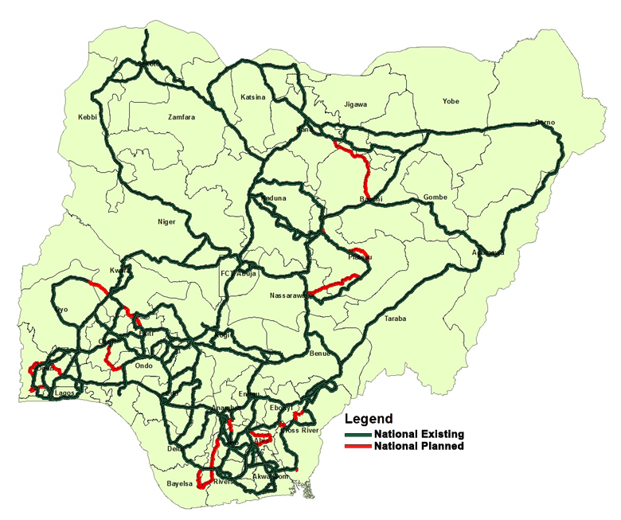

The NBP Challenge
There is presence of deployed broadband fiber infrastructure in the country, but it has not sufficiently covered the entire nation as shown in Fig. 2.
Fig. 2: National Fibre Optic Map
[Source: USPF]
Total
37,104km
7

Slide 9
The NBP Challenge
Figure 2 shows gaps between the National Planned and National Existing Broadband Fibre Infrastructure in Nigeria. This challenge has been identified by the NBP as critical to achieving broadband penetration target of 30% by 2018.
Currently in Nigeria, more than 10 terabytes of telecommunications capacity exists at the landing point, but the challenge is the deployment of fiber infrastructure across the country that will effectively distribute this capacity to the distribution nodes at the metropolitan areas of all regions in the country that will supply sufficient fiber capacity to the backbone.
8

Slide 10
The NCC Mandate
The NCC deliberately developed a strategic vision centred on eight (8) pillars to address the NBP challenges and ensure the attainment of 30% broadband penetration by 2018, among others.
8-Point Agenda
8. Ensure Regulatory Excellence & Operational Efficiency
7. Promote Fair Competition and Inclusive growth
6. Protect & Empower Consumers
5. Facilitate Strategic Collaboration & Partnership
4. Promote ICT Innovation & Investment Opportunities
3. Optimize Usage & Benefits of Spectrum
2. Improve QoS
1. Facilitate Broadband Penetration
The strategic vision of the Commission covers all identified long term plan of NBP depicted in Fig. 2. Fig. 3 is the breakdown of the NCC’s 8-point Agenda, centred on deployment of broadband infrastructure to facilitate rollout of broadband services in Nigeria.
Fig. 3: The 8-point Agenda of NCC

Slide 11
The NCC Mandate (Cont.)
The NCC unveiled its strategic vision in Lagos and later in Kano (2015) to also align its regulatory efforts with the strategic vision and goals of the ITU as shown in Fig. 4 and to further strengthen the telecommunications industry in line with NBP that will in turn lead to socio-economic development.
The framework of the ITU’s vision is based on three (3) complimentary goals: Growth, Inclusiveness and Sustainability
Growth | Enable and foster access to and increased use of telecommunications/ICTs
Inclusiveness | Bridge the digital divide and provide broadband for all
Sustainability | Manage challenges resulting from telecommunication/ICT development, innovation and partnership
Fig. 4: ITU strategic vision goals and targets [Source: ITU Strategic Plan (2016 -2019)]

Slide 12
The NBP Target Areas Addressed By The NCC Strategic Vision

Slide 13
1. Policy & Regulations
Define the open access framework and secure Right of Way (RoW) with states.
License new operators as required.
The NCC has;
Strengthened its collaborative mechanism and partnership with relevant government MDAs to improve the level of ICT adoption and use. e.g. The Commission secured the support of the Governor of Ogun state to unseal 47 base stations by an agency of the state.
Conducted several consultations on; roaming, regulation of VAS; licensing of spectrum; Industry Working Group on QoS; among many others, as well as held roundtable meetings with the Operators.
Reviewed MoUs with NASREA, Nigerian Police, etc. leading to better understanding in safeguarding the operations of base stations.

Slide 14
1. Policy & Regulations (Cont.)
Intensified efforts to facilitate the provision of law to protect telecom infrastructure as critical national infrastructure in Nigeria.
Ensured effective and transparent regulations to promote fair competition and to woo investors.
Approved the acquisition of 100% shareholding of Visafone Communication Limited in favour of MTN Nigeria Communications Limited, so that consumers who lost services can enjoy better services on uninterrupted basis.
Reviewed the International Termination Rate (ITR) for inbound traffic from N3.90/min to N24.40/min on September 16, 2016. The interim rate will subsist pending the conclusion of the study on the Determination of Cost Based Pricing for Mobile Voice Termination Rates.

Slide 15
2. Enabling Infrastructure
Incentive rollout of fibre infrastructure
Spectrum licensing for LTE in 2.5 GHz and 2.6 GHz bands
The Commission is in the process of licensing price regulated infrastructure companies that will be saddled with the task of bridging the gaps between national and planned fibre networks in Nigeria.
The BTRAIN (Backbone Transmission Infrastructure), a USPF project, is to connect the rural and semi-urban areas to the National Transmission Backbone infrastructure through Optic Fiber Cable (OFC), across the six (6) geopolitical regions of the country. So far, over 1000 km of OFC has been deployed.
Provisional approval has been given for the deployment of 4G LTE by NATCOM Development and Investment Limited, which made the first VoLTE call on February 2016.
The Commission has licensed six (6) out of the fourteen (14) slots of 2.6 GHz band to MTN (Mobile Telecommunications Network) Nigeria. This band supports capacity spectrum for the deployment of broadband services, especially in urban cities and 4G/LTE services.

Slide 16
2. Enabling Infrastructure (Cont.)
Release of spectrum on the sub-40GHz bands for mobile backhaul
The Commission plans to license the 38 GHz (range: 37 – 39.5 GHz) and 42 GHz (range: 40.5 – 43.5 GHz) bands. This will reduce pressure on the existing lower microwave frequency bands and increase broadband access across the country. Both bands are suitable for short hop (1 – 5 km) and point-to-point terrestrial links. The bands also support 3G/4G/LTE backhaul and a high degree of frequency re-use due to the high directivity of their Antennas.

Slide 17
3. Costing & Pricing
Cost-based Pricing Model
Review Spectrum Licence Fees
The Commission has;
Conducted an assessment of the transmission cable market through the analysis of market features such as pricing, regulatory climate and competition.
Considered inputs provided by stakeholders during a consultative forum in 2015 and has taken a view on parameters and regulatory measures in the light of this and other information – such as international experience and publicly available information.
Established a process of arriving at a new regime for the regulation of wholesale transmission pricing in Nigeria. This has been conducted in a climate of openness and with a view to ensuring maximum transparency to all parties without compromising the confidentiality of commercially sensitive information.
Created a model which utilizes Operators’ input in the transmission cable market and relevant inferences on the cost of providing transmission services in Nigeria and the transparency and competiveness of pricing in the transmission markets.
Implemented the comprehensive cost-model on September 1, 2016 in Nigeria.

Slide 18
4. Funding & Investment
Financial Incentives for achieving rollout targets
Funding options for accelerating broadband Infrastructure rollout
The Commission is finalizing subsidy agreements with two (2) infrastructure companies (Infracos), Infraco Nigeria Limited and I-Connect Infrastructure Services Limited for the Lagos and North Central Zones respectively to facilitate the roll-out of broadband services.
The remaining five (5) zones; North-East, North-West, South-East, South-South and South-West are in the pipeline.
The Subsidy agreement is a Public-Private Partnership (PPP) scheme in the provision of price regulated broadband services in Nigeria.
The Commission has reached an advanced stage in the implementation of a Code of Corporate Governance for the industry, that will serve to strengthen telecom legal entities and attract investment.
The Commission is engaging investors in different fora to attract Foreign Direct Investments (FDI).

Slide 19
5. Driving Demand
Set up Public Access Points and ICT Training Centre's
Connect all Universities, Schools, Colleges and Hospitals
BTS Project - Deployment of BTSs (Base Transceiver Stations) and certain passive infrastructure in the under-served and un-served communities where market viability is weak. Sites involved include: 58 sites in the Southwest, 36 sites in the South-South and 12 sites in the Federal Capital Territory (FCT).
RuBI–Pilot - Subsidies are provided to operators for the deployment of networks to support the establishment of core delivery mechanisms for broadband services in rural/semi urban areas. The deployment of infrastructure for broadband service provisioning is ongoing under the RUBI project initiative in 14 locations across the country.
Rehabilitation of ECC facilities in fourteen States for improved security of lives and property of Nigerians, and aid response agencies in receiving emergency calls for prompt assistance.
Established Virtual Examination Centres in two selected WAEC approved Secondary Schools in the Northern and Southern Zones.
Data Sharing, e-Learning Platforms & ICT Infrastructure for four (4) Universities and Teaching Hospitals in the Northern and Southern Zones.

Slide 20
5. Driving Demand (Cont.)
Set up Public Access Points and ICT Training Centre's
Connect all Universities, Schools, Colleges and Hospitals
Training facility with modern infrastructure to promote learning at DBI Learning Centres in Yola, Enugu, Asaba and Oshodi.
UnICC Project - This is a USPF support project to deliver broadband infrastructure using OFC to Universities to facilitate research and learning. At the moment the deployment of OFC is ongoing in 9 (nine) Universities.
Schools and Tertiary Institutions Knowledge Centres across the country to equip students and their neighboring communities with ICT Learning tools.
UnICC-Electronics - The Project involves interconnecting end-user Electronics within the University Campus. Currently, provision of connectivity is ongoing in five (5) Universities across the country.
Stakeholder Initiated Projects (SIP) - Provision of ICT/CBT (Information and Communications Technology/Computer Based Test) Centres. Currently, twelve (12) ICT/CBT Centres have been completed in various institutions and locations across the country under the SIP initiative, and an additional four (4) Skills Acquisition Centres are scheduled for completion

Slide 21
6. Building Fibre Infrastructure
Build metro fibre networks in all the major cities and state capitals.
Incentivize building of last mile wireline infrastructure to homes, etc.
Extend international cable landing points to other coastal states.
The Commission has;
Articulated a robust regulatory framework that will enable strategic and systematic licensing and deployment of broadband infrastructure across the country – The Open Access Model.
Established a Broadband Implementation & Monitoring Committee to give proper assessment on regular basis of broadband infrastructure deployment.
Fine tuned the Infrastructure provision licenses awarded for the Lagos and North Central zones.
Advertised the bidding and selection process for interested service providers (Infrastructure Companies – Infracos) in the remaining five zones namely; North-East, North-West, South-East, South-South and South-South.
The mandate of the Infracos is to provide & operate infrastructure services and to facilitate broadband penetration, i.e. provide and optimize access to and use of affordable fixed and mobile broadband everywhere in Nigeria.

Slide 22
7. Wireless Broadband Infrastructure Upgrade & Expansion
All cell sites to be LTE compatible.
Spread 3G to at least 50% of the population
One slot of 30MHz frequency in 2.3GHz was licensed to Bitflux for the provision of Wholesale 3G Wireless Access Services.
The Commission has re-planned the 23 GHz microwave frequency band for backhauling, which is strategic to supporting the throughput of point-to-point digital fixed wireless systems and mobile infrastructure in Nigeria.
The Commission has approved for Etisalat and Airtel to re-farm part of their 1800 MHz band, so as to roll-out 4G LTE.

Slide 23
Current Broadband Penetration

Slide 24

Broadband Penetration
MOBILE & INTERNET BROADBAND PENETRATION
Mobile and Internet broadband penetration is relevant due to its rapid diffusion into the economic and social growth of developing countries.
The ITU and UNESCO Broadband Commission for Sustainable Development releases statistics on broadband penetration levels for ITU member states, so that respective countries can gauge performance based on their set National Broadband Plan goals.

Slide 25
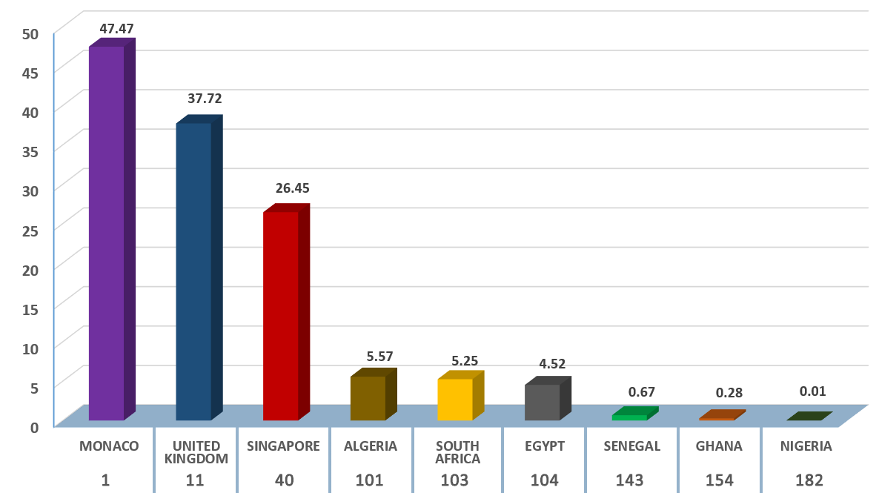

Broadband Penetration (Cont.)
Table 1: FBS in selected ITU Member States [Source: The State of Broadband]
MEMBER STATE | FBS/100 | RANK
Monaco | 47.47 | 1
United Kingdom | 37.72 | 11
Singapore | 26.45 | 40
Algeria | 5.57 | 101
South Africa | 5.25 | 103
Egypt | 4.52 | 104
Senegal | 0.67 | 143
Ghana | 0.28 | 154
Nigeria | 0.01 | 182
Member State & Ranking out of 190
Fig. 5: Bar chart for Active Fixed-Broadband Subscription per 100 inhabitants (FBS) in selected ITU Member States.

Slide 26
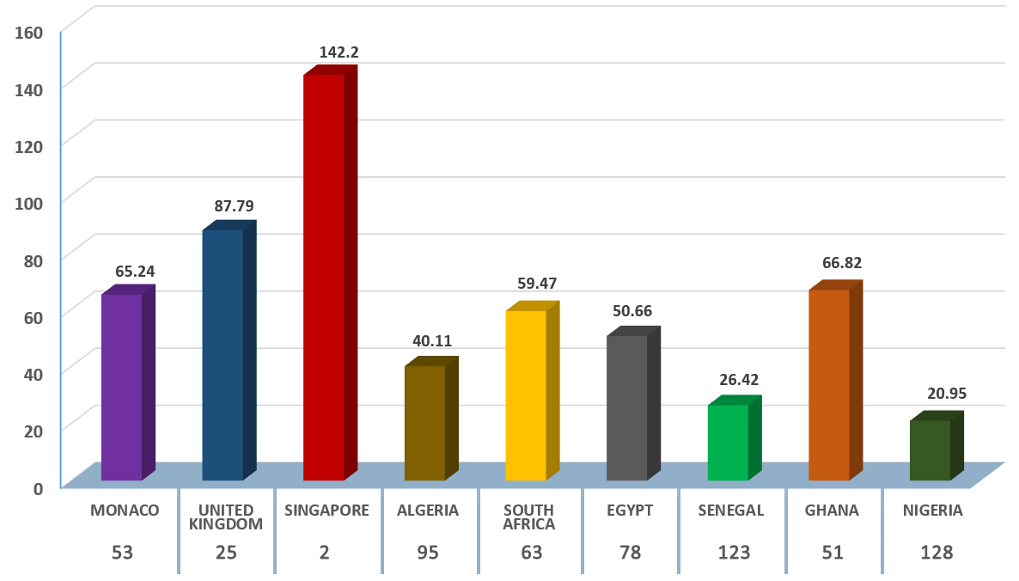
Broadband Penetration (Cont.)
Table 2: MBS in selected ITU Member States [Source: The State of Broadband]
MEMBER STATE | MBS/100 | RANK
Monaco | 65.24 | 53
United Kingdom | 87.79 | 25
Singapore | 142.2 | 2
Algeria | 40.11 | 95
South Africa | 59.47 | 63
Egypt | 50.66 | 78
Senegal | 26.42 | 123
Ghana | 66.82 | 51
Nigeria | 20.95 | 128
Member State & Ranking out of 190
Fig. 6: Bar chart for Active Mobile Broadband Subscription per 100 inhabitants (MBS) in selected ITU Member States.

Slide 27
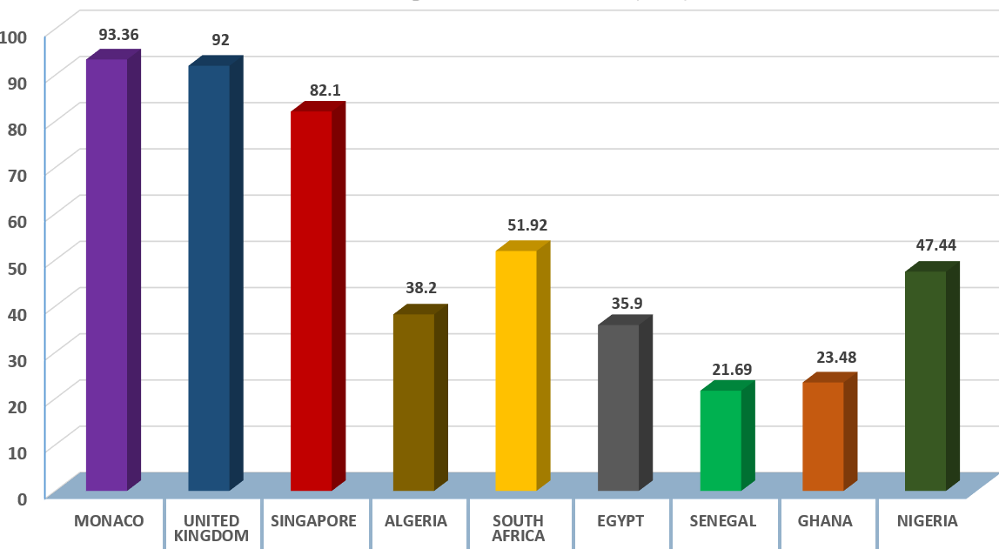
Broadband Penetration (Cont.)
Table 3: PII in selected ITU Member States [Source: The State of Broadband]
MEMBER STATE | PII | RANK
Monaco | 93.36 | 8
United Kingdom | 92 | 13
Singapore | 82.1 | 28
Algeria | 38.2 | 114
South Africa | 51.92 | 87
Egypt | 35.9 | 116
Senegal | 21.69 | 127
Ghana | 23.48 | 132
Nigeria | 47.44 | 96
8 13 28 114 87 116 127 132 96
Member State & Ranking out of 190
Fig. 7: Bar chart for Percentage of Individuals using the Internet (PII) in selected ITU Member States.

Slide 28
Broadband Penetration (Cont.)
MOBILE & INTERNET PENETRATIONS
Nigeria's Active Mobile Broadband Penetration has reached 20.95 % relative to less than 10 % a year ago.
Furthermore, Percentage of Broadband Internet Penetration has reached a milestone of 47.44 % second to South Africa in Africa.
This is strongly attributed to the robust regulatory framework of the Commission.

Slide 29
Economic and Social Benefits

Slide 30
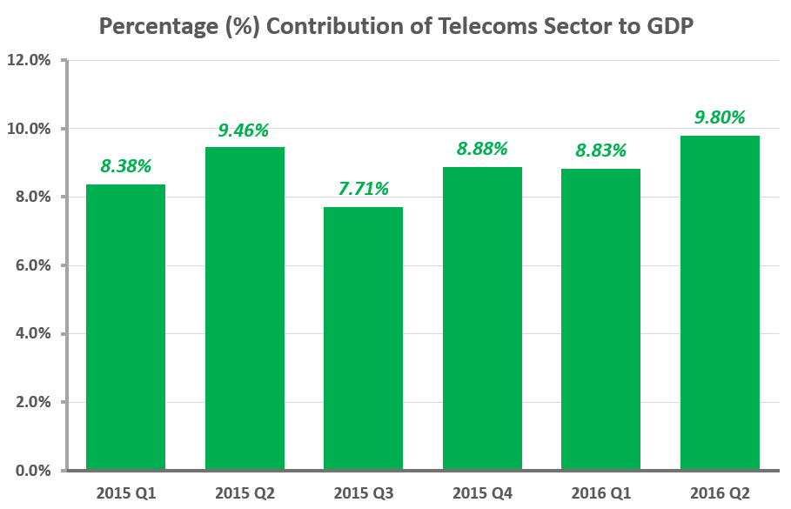
Economic Benefits
The National Bureau of Statistics (NBS) reports that:
In the Second Quarter (Q₂) of 2016, the telecommunications sector contributed N1,580 billion to GDP i.e. 9.8 %, which is the largest in the rebased period. This is an increase of 1% compared to the First Quarter, indicating robust growth.
The share of telecommunications in total real GDP has grown in the last five quarters.
Fig. 8: Contributions of Telecoms Industry to GDP (2015 Q1 – 2016 Q2)

Slide 31
Social Benefits
The report confirmed economic development and deployment of broadband Infrastructure are linked, specifically in growth, employment and productivity:
Job creations – Indirect employment in the form of business center's; vendors, kiosks, operators call center's, umbrellas, shops and computer villages that requires less capital.
Efficient business and government processes to improves productivity and service delivery.
Participatory Governance – transparent and accessible e-governance (interactive suggestions) and participation.
Blurring boundaries of social identities – improved access to mobility and information for disadvantaged people and communities.

Slide 32
Social Benefits (Cont.)
Social interactions – using OTT platforms (Facebook, WhatsApp, etc.) to share information.
Reduce inequality of opportunities between rural and urban dwellers.
Increase efficiency and reduce cost of data services.
Consumer surplus – Efficient access to information through the Internet, saving and improvement in transport (e-tickets), education (teleconferencing, e-library, distance learning), health (telemedicine, e-diagnoses), commerce (e-banking, mobile money), etc.

Slide 33
Conclusions
The FGN has developed the NBP to foster a five-fold broadband penetration over a span of five (5) years (2013 – 2018).
The NCC unveiled its strategic vision (2015 – 2020) and aligned it with the NBP to address the challenge of deployment of fiber infrastructure across the country.
The results of the alignment shows that:
Active Mobile Penetration has risen within the space of one year from less than 10% to 20.95%.
Internet Penetration reached a milestone of 47.44%, only second to South Africa in Africa.
The contribution of telecommunications to GDP is 9.8% in the Second Quarter of 2016, which is the largest in the rebased period, with an increase of 1% compared to First Quarter, indicating robust growth.
The share of telecommunications in total real GDP has grown in the last five quarters.

Slide 34
Conclusions (Cont.)
The telecommunications sector is certainly moving in the right direction and the Commission is further repositioning itself to address the dynamics of the industry.
We will continue to attract investors through our friendly and well articulated regulatory frameworks and code of corporate governance.
In general our sector has contributed substantially to the socio-economic transformation of the country in areas of employment, productivity and economic growth as well as GDP.

Slide 35
THANK YOU
Prof. Umar Garba Danbatta, FNSE, FRAES
ugdanbatta@ncc.gov.ng

